Slide 1


THE BDM CAPSTONE PROJECT
Indian Institute of Technology Madras, Chennai, Tamil Nadu, India, 600036
Optimizing Revenue Inflow and Resource Management by Utilizing Retail Store and Institutional Sales Data for a B2C Furniture Firm
Presented By- Nandani Gupta
Roll No.- 21f1005928

Slide 2
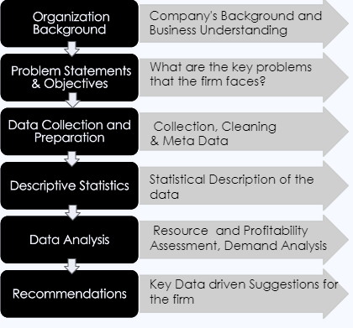
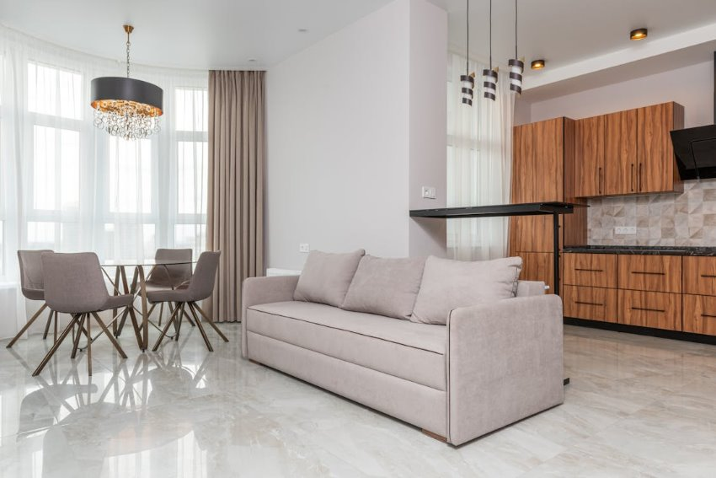

Project Flow

Slide 3
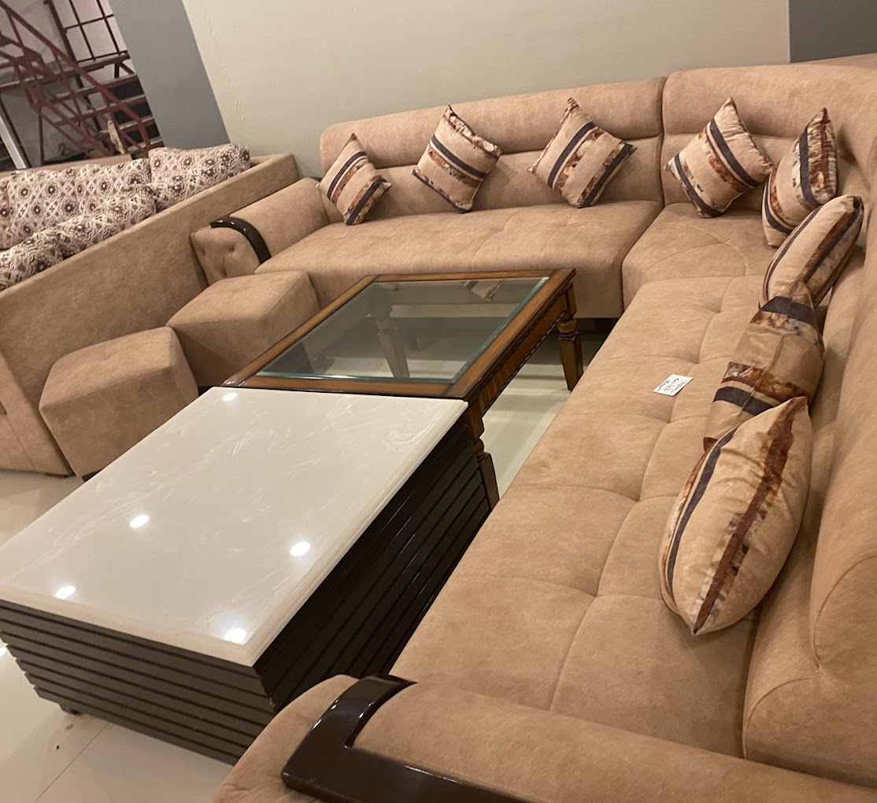
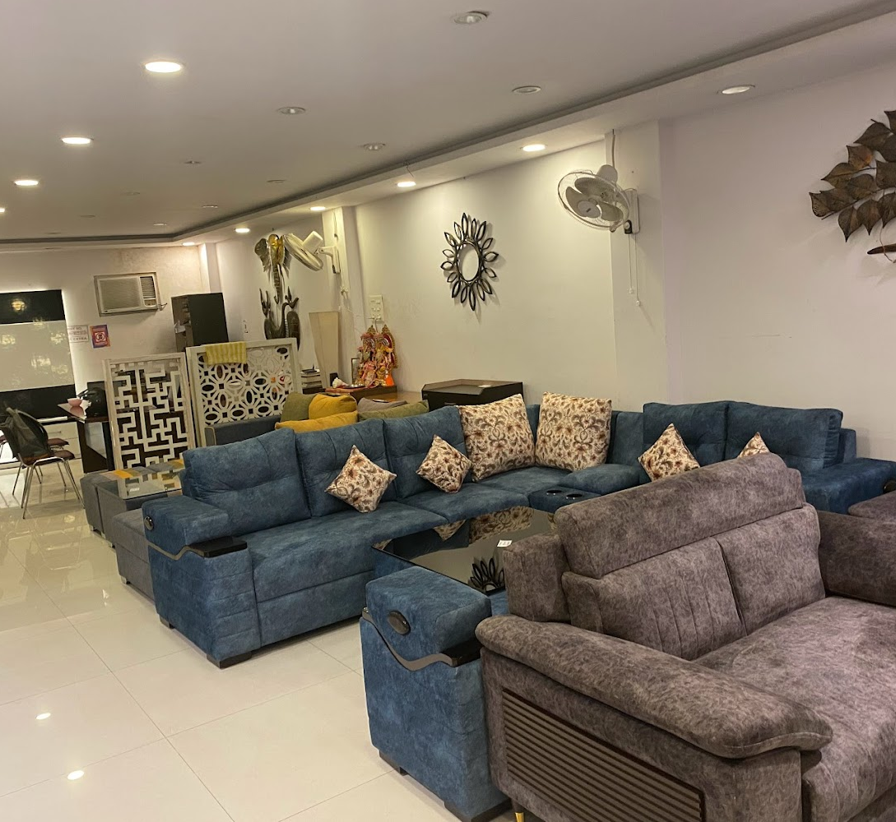
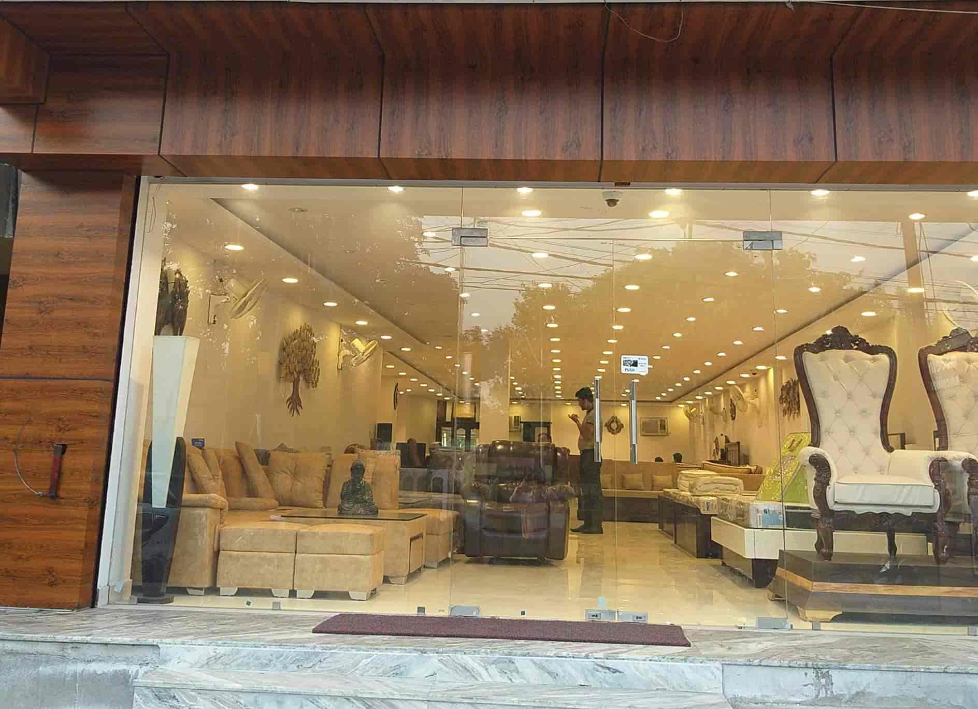
ORGANIZATION BACKGROUND
The firm, established in 1987 is a renowned (B2C) furniture firm in Kanpur. Their product range spans from classroom furnishings to modular kitchens and living room furniture.
It has two key sales channels – retail outlets and the gem portal for government-based tenders. ​​​
It's clientele include institutions like medical colleges and IITs, making it a trusted provider of quality furniture.​​​
The firm deals in both in-house manufactured furniture and branded products from international brands like Spacewood and Kurlon based on customer preferences.​​​
Their services include customization options, expert advice on furniture selection, efficient delivery services, and after-sales support to ensure a seamless experience for their clients.

Slide 4

Problem Statements & Objectives
Resource Allocation b/w Retail Outlets vs Institutional Sales
Impact of new Showroom Launch amid Market Slowdown
Product Demand Analysis in the online Marketplace
Determining the distribution and profitability of business between these channels to optimize revenue generation and sales strategies effectively.
Assessing the impact of launching a new showroom on the firm's overall sales performance and analyzing its contribution to the company's sales to determine its effectiveness in boosting sales.​
Identifying the top performing products in the gem portal shall help the firm pivot it's competitive positioning against ecommerce and other sellers in these categories.

Slide 5





Data Collection & Preparation
Data Collection
Data Preparation
Meta Data
The firm was approached and a mutual understanding was built.
After multiple brainstorming sessions with the stakeholders,the problems and relevant data for our analysis was identified.
Under the condition of confidentiality, various proofs of the originality along with the data were collected.
Main data sources were- company's internal database and gem portal.
The data for each year was aggregated in multiple excel sheets and converted into pivot tables for better evaluation.
Thereon, data was checked for null values and any discrepancies using excel and BI tools. Notably, data has no null values.
Data was standardized and various derived fields were created for ease of evaluation.
The data acquired consists of monthly Retail Showroom sales data, Balance Sheet Data, P/L Statements, Gem Portal Data for 5 years from years 2018-2023.
The top fields are- Monthly sales, Order Details, Order Quantity, Net Profit/Loss, Gross Profit, distribution of the company's assets, liabilities, and shareholders' equity, Closing and Opening Stock, Expenses etc

Slide 6

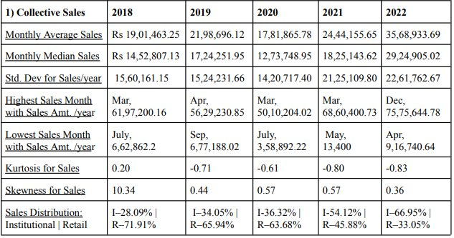
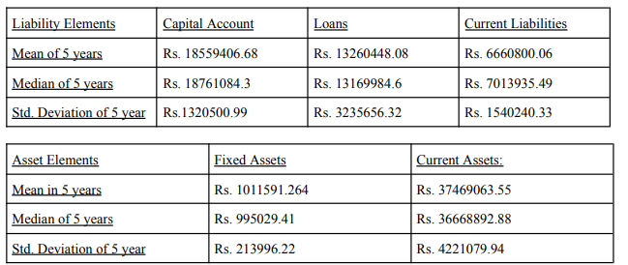
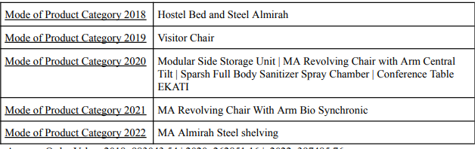
DESCRIPTIVE STATISTICS
Key Insights
Collective Sales Data
Highest Sales Month- March Lowest Sales Month – July Lower demand for furniture in first half of the year
Despite low institutional spending in 2022, it contributed 66.95% of total sales, achieving the highest sales value.
Balance sheet data
2022 had the highest total sales, while net profit peaked in 2018 and gross profit in 2019. New Outlet lowered the net profit 2019
Product Details Data
Highest Sales Product in 2018- Hostel Bed and Steel Almirah Highest Sales Product in 2022- MA Almirah Steel shelving

Slide 7
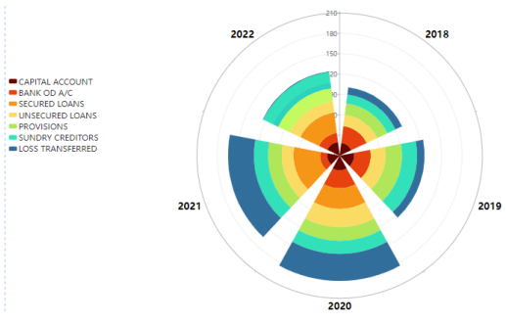
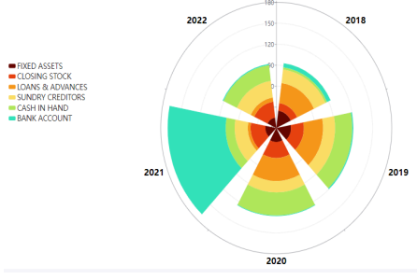
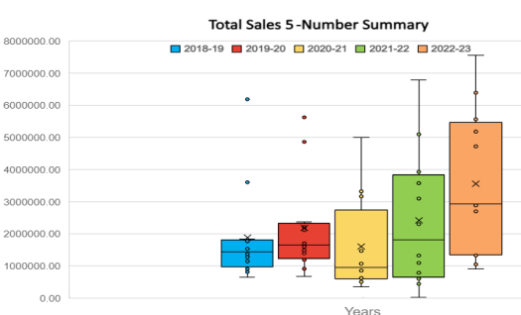
Data Analysis
​
​
​
Resource Assessment &
​Performance Analysis
This method evaluate the efficiency of resource allocation and the performance of sales and profitability between retail and institutional sales channel, understanding the influence of new outlet, covid 19 pandemic and market downturn.
Liability Elements
Asset Elements
Both the median, Q1, and Q3 values showed an upward trend each year, reflecting consistent growth in sales. IQR indicates a nearly 4.8 times growth in sales range in 5 years.​
In both 2018 and 2019, outliers were on the upper end of the sales data indicating a few high-value transactions skewed the average upwards.​
The individual liability elements have a tendency to increase year on year, while the individual asset elements have shown a trend of decrease in 5 years, except for closing stock amount.​
Total Liabilities have always been higher than total assets throughout the years. However in 2022, the growth in assets (8.61%) from the previous year outpaced the increase in liabilities (1.16%), indicating a positive trend.

Slide 8
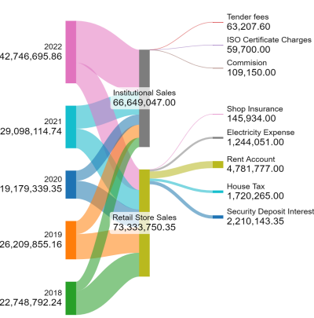
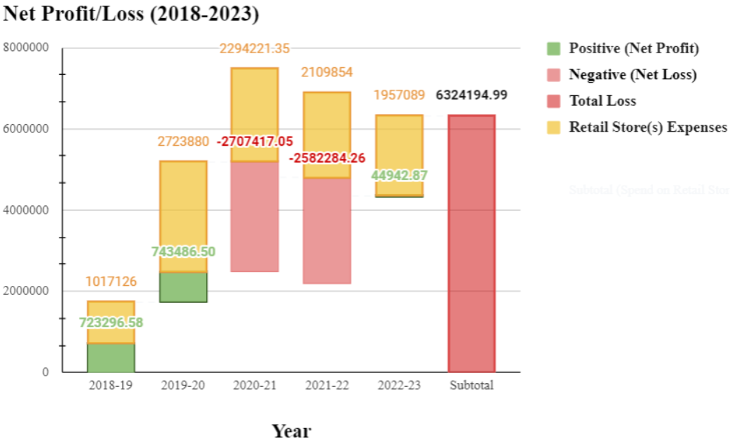
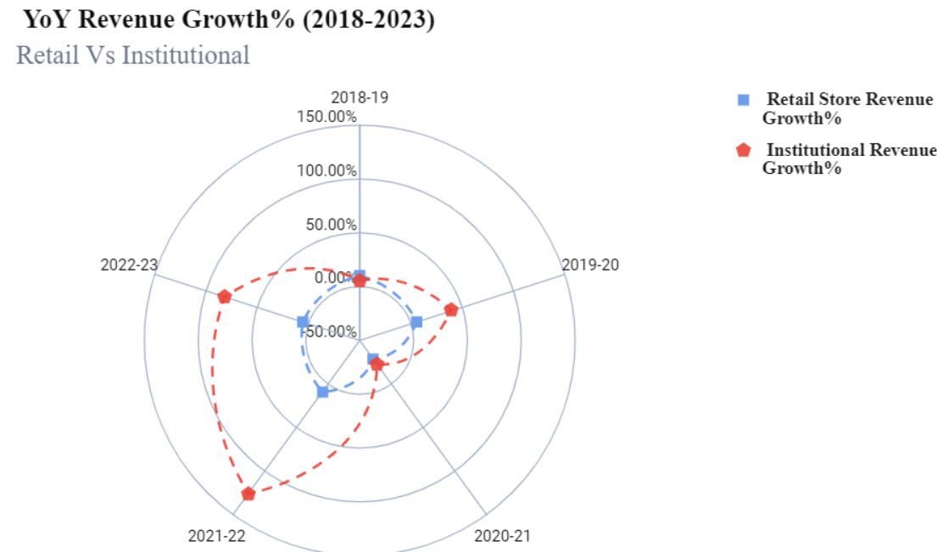
Data Analysis
Resource Assessment &
Performance Analysis
A balanced relationship between net profit and retail expenses is observed before the launch of new outlet in 2018.
Post the launch of new outlet in 2019, retail expenses surged absorbing a substantial portion of gross profit resulting in a minimal net profit growth of 2.8%.
Despite a notable decrease in sales during pandemic in 2020, the closing stock continued to rise which correlated with amount of sundry creditors, contributing to higher liabilities for the firm.
Institutional Sales show considerably lower expenditures at only 0.348% of total institutional sales compared to Retail Sales.
Institutional sales expenditure has lower recurring expenses compared to Retail business.
Institutional Sales shows net sales growth rate of 231.11%, in stark contrast to the modest 2.01% for retail sales.
Covid-19 impact in 2020 resulted in negative growth rate for both sectors, but Institutional sales recovered with 126.10% rate, while retail sales managed only 9.3% in 2021.

Slide 9
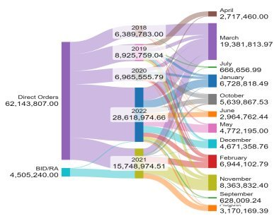

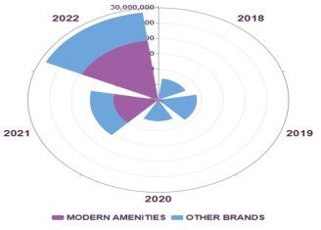
Data Analysis
​
​
​
Product Demand Analysis
➔ The total contribution from Direct orders (62,143,807) significantly surpasses that of the BID/RA method (4505,240) consistently across all years.
➔ Direct orders, which are the orders below 5 lac rupees are more frequently placed as compared to Orders through Bidding method.
➔The firm witnessed a remarkable surge in its in-house manufactured product demand, from no revenue in 2018 to 19,491,386 Rs in 2022.
Product Demand Analysis in the Online Marketplace involves evaluating the demand for Firm's' products in the digital sphere. This analysis delves into various aspects of online product performance, customer behavior, and market trends to gain insights that can provide firm a competitive edge.
​
Other Brands: Blue​
In-house: Purple

Slide 10
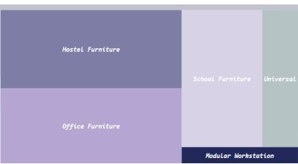
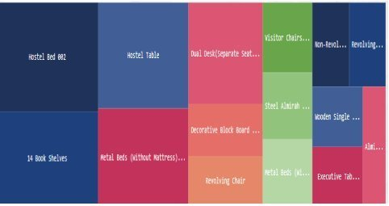
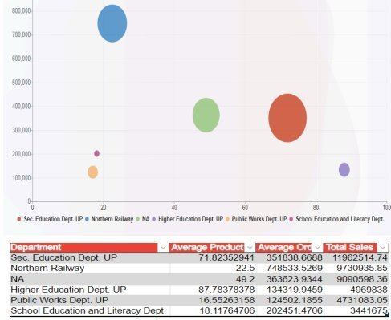

DATA ANALYSIS
​
​
​
Product Demand Analysis
Product Demand Analysis
​
​
➔ The top government buyer is the Secondary Education Department, Uttar Pradesh.
​
➔ Hostel Furniture and Office Furniture emerge as top sellers in the institutional business, closely followed by School Furniture.
➔ 3 out of the top 5 products belong to the hostel category, namely Hostel Bed 002, Hostel Table, and Metal Bed. Together, they account for 6.7% of the total sales over 5 years​.

Slide 11


RECOMMENDATIONS
Evaluate New Retail Outlet Expenses: Assess costs associated with the new retail outlet and explore cost-reduction strategies (e.g., relocating to a lower-rent location, renegotiating leases, optimizing staffing, targeted marketing).
Allocate Resources to Manufacturing Optimization: Reallocate saved retail store expenses toward optimizing manufacturing costs for competitive pricing.
Focus on Top-Performing Products: Offer promotions, competitive pricing, and exclusive deals for high-demand products identified in online marketplace analysis.
Highlight In-House Manufactured Products: Capitalize on unique features, quality, and value proposition to gain a competitive edge.
Implement Targeted Sales Strategies: During peak demand (e.g., March), use promotions, discounts, and bundled deals to attract customers.
Optimize Stock Levels: Align stock levels with yearly sales trends to avoid overstocking and reduce excess inventory costs.

